Slide 1
Parallel and Distributed Computing
Dr. Hammad Afzal
Military College of Signals
National University of Sciences and Technology, Pakistan
Spring, 2011
hammad.afzal@mcs.edu.pk
https://sites.google.com/a/mcs.edu.pk/codteem/

Slide 2
Agenda
Course Details
Assignment/Class Policy
Introduction to Distributed Systems

Slide 3
Resources
Text Book
Distributed Systems : Concepts and Design
By: George Coulouris, Jean Dollimore and Tim Kindberg: 4th Edition
Reference
Tanenbaum, Andrew S and van Steen, Maarten, Distributed Systems, Principles and Paradigms, Prentice Hall
Java Programming Books
More references will be given after each lecture (if there are any)

Slide 4
Grading Policy
Assignments/Case Studies 10%
Quizzes 10%
Mid Terms 30%
End-term 50%
Lectures & Handouts
Will be available on LMS
Quizzes
Mostly unannounced
Occasionally announced

Slide 5
Policies – Attendance
Deficiency in attendance may lead to termination or relegation

Slide 6
Course Outline
Characterization of distributed systems (chap 1)
System Models
Networking and Internet
Inter-process Communication
Distributed Objects and Remote Invocation
Operating system support
Security
Distributed File system
Name service
Peer to peer systems

Slide 7
Course Outline
Coordination and agreement
Transaction and concurrency control
Distributed transactions
Distributed shared memory
Web Services
Semantic Web Services
Cloud Computing

Slide 8
Today’s talk
Introduction and History
Examples of distributed systems
The internet
Interanets
Moble and ubiquitous computing
Notes:
Lack of universal vocabulary
Beware that some of the defined terms may not have the same definition in other contexts.
Networks of computers are everywhere. Examples, company, office, mobile phone.
We aim to explain the characteristics of the networked computers and techniques that have been developed to help in the tasks of designing and implementing systems that are based on them.

Slide 9
Distributed System
Definition
A distributed system is a collection of independent computers that appears to its users as a single coherent system [Tanenbaum].

Slide 10
Distributed System
Definition
A distributed Systems is one in which components located at networked computers communicate & coordinate their actions only by passing messages (No global clock).
Entire Range of systems in which networked computers can be deployed.
Examples
Computer world: University computer network
Ordinary life:
WWW, P2P systems (such as Azureus etc)
Banks (Cash machines)

Slide 11
Distributed System
Challenges
Heterogeneity
Software
Hardware
Middleware
Layer of software
Logically placed between Application layer and operating system layer.
Support Heterogeneity:
Difference between the computers and the way they communicate with each other (hidden from the user).

Slide 12
Distributed System
Consistent interact regardless of where the interaction takes place.
E.g. WinSCP

Slide 13
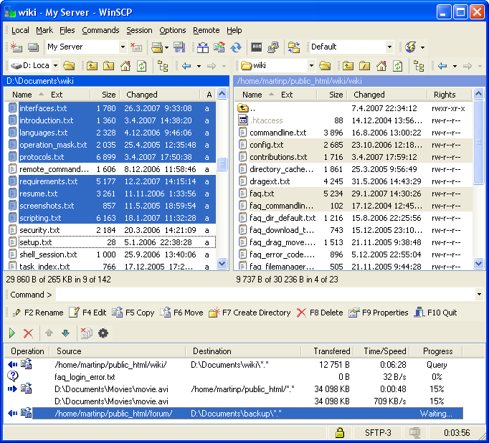
Distributed Systems
Example: WinSCP

Slide 14
Characteristics of Distributed System
Concurrency of components
Lack of a global clock
Independent failures of components

Slide 15
Concurrency
Concurrent execution of tasks, a usual practice.
In Lab, I do my work on my computer and you do your work on yours.
Also, you sharing resources as well, e.g.
Disks, Printers
Files, Web Pages
Co-ordination required between concurrently executing programs that share resources.
Notes:
Concurrency:
Concurrent execution is the normal thing in distributed systems.
I do my work on my computer and you do your work on yours, sharing resources such as web pages or files when necessary.
Capacity of the system to handle the shared resources can be increased by adding more resources to the network.
The coordination of concurrently executing programs that share resources is also an important & recurring topic.

Slide 16
No Global Clock
No Global Clock.
Only communication by passing messages.
Notion of Clock may be used in controlled environment
Applications running on Local Area Network

Slide 17
Independent Failures
Components of Distributed systems can fail.
Networks (Communication)
Computers (Devices)
Each component can fail independently, leaving the others still running.
System Designer to plan for the consequences of possible failures.
Network Failures
Isolation of computers: Network failure doesn’t mean computer stop working.
Programs may not be able to detect whether the network has failed or has become unusually slow.
Notes:
All computers system can fail & it’s the responsibility of system designer to plan for the consequences of possible failures.
In dist sys, faults in the network result in the isolation of the computers that are connected to it, but that does not mean they stop running.
Programs may not be able to detect whether the network has failed or has become unusually slow.
Similarly an unexpected termination of a program somewhere in the sys is not immediately made known to other components with which it communicates
Each component can fail independently, leaving the others still running.

Slide 18
Independent Failures
Computer/Process Failures
Unexpected termination of a program somewhere in the system is not immediately made known to other components with which it communicates
E.g. ?
Notes:
All computers system can fail & it’s the responsibility of system designer to plan for the consequences of possible failures.
In dist sys, faults in the network result in the isolation of the computers that are connected to it, but that does not mean they stop running.
Programs may not be able to detect whether the network has failed or has become unusually slow.
Similarly an unexpected termination of a program somewhere in the sys is not immediately made known to other components with which it communicates
Each component can fail independently, leaving the others still running.

Slide 19
Motivation for Distributed Systems (details from Book and slides at the end)
Resource sharing
Communication
Speed
10000 CPU running at speed of 50 MIPS
500,000 MIPS
Economy
Incremental growth
Reliability

Slide 20
Resource Sharing (1)
Sharing of resources is the main motivation for constructing dist system
The term Resource is rather abstract one, but it best characterizes the range of things that can usefully be shared in a networked computer system.

Slide 21
Resource Sharing (2)
Hardware: Disks & printers
Software-defined entities: files, databases & data objects of all kinds.
Resources are managed by servers and accessed by clients
Resources are encapsulated as objects & accessed by other client objects

Slide 22
Resource sharing (3)
Service:
A distinct part of a computer sys that manages a collection of related resources
Presents their functionality to users
File Services
Printing Service
E-payment Service

Slide 23
Resource sharing (4)
Service:
The only access to the service is via set of operations that it exports.
File service (Operations: read, write & delete)
In Distributed Systems
Resources in distributed systems are physically encapsulated within computers.
Can only be accessed from other computers by communication.

Slide 24
Resource sharing (5)
Server, client and message
Remote Invocation
A complete interaction between client & a server from the point when the client sends its request to when it receives the server’s response, is called remote invocation.
The terms ‘client’ & ‘server’ apply only to the roles played in a single request.

Slide 25
Resource sharing (6)
By default the terms ‘client’ & ‘server’ refer to processes rather than the computers that they execute upon.
Servers run continuously
Clients last as long as the application of they form a part
Many, but certainly not all, dist sys can be constructed entirely in the form of interacting clients & servers.
The World Wide Web, email & networked printers all fit this model.

Slide 26
Examples of Distributed Systems
Internet
Intranet
Mobile and ubiquitous computing

Slide 27
Internet
A very large distributed system
A vast interconnection of computer networks of many different types.
The set of services is open-ended – it can be extended by the addition of server computers & new types of services
Programs running on the computers interact by passing messages.
Notes:
Internet
World Wide Web offers a simple, consistent and uniform model of distributed documents. To see a document user may activate a reference and document appears on the screen.
Intranet (portion of internet managed by an org)
Network of stations are there in a university department. Every user has its own workstation. But in addition there may be a pool of processors in the machine room that are not assigned to these users. But are allocated dynamically as needed.
When user types a command the system could look for the best place to execute it. Either on the same workstation or somewhere else on the unassigned processors and at the end results are delivered back.

Slide 28
Internet
ISPs
provide modem links & other types of connection.
To access services anywhere in the internet.
Back bone
a network link with a high transmission capacity, employing satellite communications, fiber optics & other high bandwidth etc.
Notes:
ISPs provide modem links & other types of connection to individuals and small organizations enabling them to access services anywhere in the internet.
A back bone is a network link with a high transmission capacity, employing satellite communications, fiber optics & other high bandwidth etc.
Multimedia services are available in the internet, enabling user to access audio & video data – limited facilities

Slide 29
A typical portion of the Internet
intranet
%
ISP
%
%
%
backbone
satellite link
desktop computer:
server:
network link:

Slide 30
Intranets
Portion of the Internet
Separately administered
Boundary that can be configured to enforce local security policies.
An intranet is connected to the internet via a router

Slide 31
Intranets
Firewall
To protect an intranet by preventing unauthorized messages leaving or entering
Allow only those messages related to email & web access to pass into or out of the intranet that it protects.
Perfect Firewall
Police, Ministry of Defense, Security organizations.

Slide 32
A typical intranet

Slide 33
Mobile & ubiquitous computing
Miniaturization of devices and wireless networking
Integration of small & portable computing devices into dist sys. These devices include:
Laptop computers
Handheld devices, including personal digital assistants (PDAs), mobile phones, pagers, video cameras and digital cameras
Notes:
Miniaturization of devices and wireless networking
Technology advances in device miniaturization & wireless networking have led increasingly to the integration of small & portable computing devices into dist sys. These devices include:
Laptop computers
Handheld devices, including personal digital assistants (PDAs), mobile phones, pagers, video cameras and digital cameras
Devices embedded in appliances such as washing machines, hi-fi sys, cars & refrigerator

Slide 34
Mobile Computing
Mobile computing is the performance of computing tasks while the user is on move or visiting places other than their usual environment.
User who are away from their home intranet are still provided resources via the devices they carry with them
Location-aware computing:
Utilize resources that are conveniently nearby.
Notes:
The portability of many of these devices, together with their ability to connect conveniently to networks in diff places, makes mobile computing possible.
Mobile computing is the performance of computing tasks while the user is on move or visiting places other than their usual environment.
User who are away from their home intranet are still provided resources via the devices they carry with them
Provision to use to utilize resources such as printers that are conveniently nearby as they moved around (location-aware computing)

Slide 35
Portable and handheld devices in a distributed system
Notes:
Mobile phone net, campus net, home net, in-car net, all of these, both separately and in combination, share the essential characteristics that come under the distributed system.
Computers that are connected by a network may be spatially separated by any distance. They may be on separate continents, in the same building or in the same room.

Slide 36
Ubiquitous computing (Being everywhere)
The most profound technologies are those that disappear. They weave themselves into the fabric of everyday life until they are indistinguishable from it”
Mark Weiser
Chief Scientist at Xerox PARC
Father of Ubiquitous Computing
Coined this term in 1988.
Notes:
Mobile & ubiquitous computing raise significant system issues:
How to support the discovery of resources in the host environment?
Eliminating the need for users to reconfigure their mobile devices as they move around
Helping users to cope with limited connectivity as they travel
Providing privacy & other security guarantees to users & the environment that they visit

Slide 37
Ubiquitous computing (Being everywhere)
Ubiquitous computing is the harnessing of many small, cheap computational devices that are present in user’s physical environment.

Slide 38
Ubiquitous computing (Being everywhere)
Could benefit users while they remain in a single environment such as home or a hospital
Devices embedded in appliances such as washing machines, refrigerator
E.g. Universal Remote Control ?
The presence of computers everywhere only becomes useful when they can communicate with one another.

Slide 39
Additional References/Slides

Slide 40
Resource Sharing: E-science
An infrastructure for
systematic development of research methods that involve distributed resources (Web services, data and knowledge resources, and computational resources)
and their application to research

Slide 41
e-Science Resources
The resources involved in e-Science are known as e-Science resources, which can be
Scientific literature databases (e.g. PubMed, PubChem etc).
Tool repositories (e.g. bioinformatics tools and services provided by the European Bioinformatics Institute (EBI) etc).
Social network like portals where scientists can exchange knowledge and comments etc (e.g. myExperiment, F1000 Biology).

Slide 42
Resource Sharing
Example screenshots
http://www.ncbi.nlm.nih.gov/pubmed/
http://www.ebi.ac.uk/services/
http://www.ebi.ac.uk/Tools/sss/fasta/
http://taverna.sf.net/images/taverna-1.5.1.6.png
http://wiki.bioclipse.net/images/Taverna600.png

Slide 43
Ubiquitous computing (Being everywhere)
Another term commonly used “Pervasive Computing” : means Spread throughout
Similar to Ubiquitous Computing
Example:
Body Area Network (BAN)
Sensor Networks

Slide 44
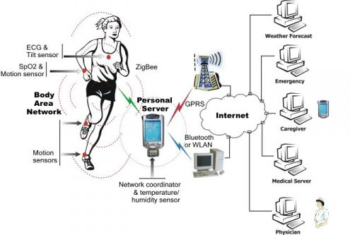
Ubiquitous computing (Being everywhere)
Body Area Network

Slide 45
"If you were plowing a field, what would you rather use,
two strong oxen or 1024 chickens?"
- Seymour Cray, Founder of Cray Research

Slide 46
Courtesy
Following people’s lecture slides have also been consulted during the preparation of this lecture.
Dr. Rehan Rasool (SEECS)
Umar Kalim (Ex-SEECS)
Dr. Faisal Bashir (MCS)

Slide 47
End of Week1

